Slide 1
BLOCKCHAIN & DECENTRALIZED FINANCE
Blockchain, Bitcoin and Decentralized Finance

Slide 2
Blockchain & DeFi – Day 1
The Biggest Bankruptcy
Fall of Lehman Brothers in 2008, 4th largest US investment bank was a tipping point.
It created a gap for a system that is:
  Transparent
  Governed by same law everywhere
  Does not have single point of failure
  Disallows double spending.

Slide 3
Blockchain & DeFi – Day 1
The Biggest Bankruptcy
Fall of Lehman Brothers was a tipping point.
It created a gap for a system that is:
  Transparent
  Governed by same law everywhere
  Does not have single point of failure
  Disallows double spending.
Answer: Blockchain
Notes:
In 2008, 4th largest US investment bank, Lehman Brothers collapsed after massive exposure to risky mortgages led to huge losses, a loss of confidence, and a liquidity crisis.

Slide 4
Blockchain & DeFi – Day 1
Blockchain
Example: A generic account book (کھاتہ) of shopkeepers.
Simple format: Date, Name, Out, In, Balance, Description
First entry on new page is the closing balance from pervious page
Tempering anything in the past means you must adjust every page after
Notes:
Not using accounting terms like Debit and Credit. A shopkeeper also maintains the same without knowing what an accounting ledger is.
A blockchain ledger is conceptually similar to an accounting ledger: it records transactions that change the state or balances of accounts, but a blockchain distributes that ledger across a network rather than having one institution maintain the authoritative copy.

Slide 5
Blockchain & DeFi – Day 1
Blockchain
Blockchain: a public ledger of transactions
Block: a collection of transactions; each block knows about the previous block (like pages linked in the account book)
Transaction: an event of transfer of assets of certain value from a sender to a receiver with a timestamp.
Account: a unique number which holds digital assets.

Slide 6
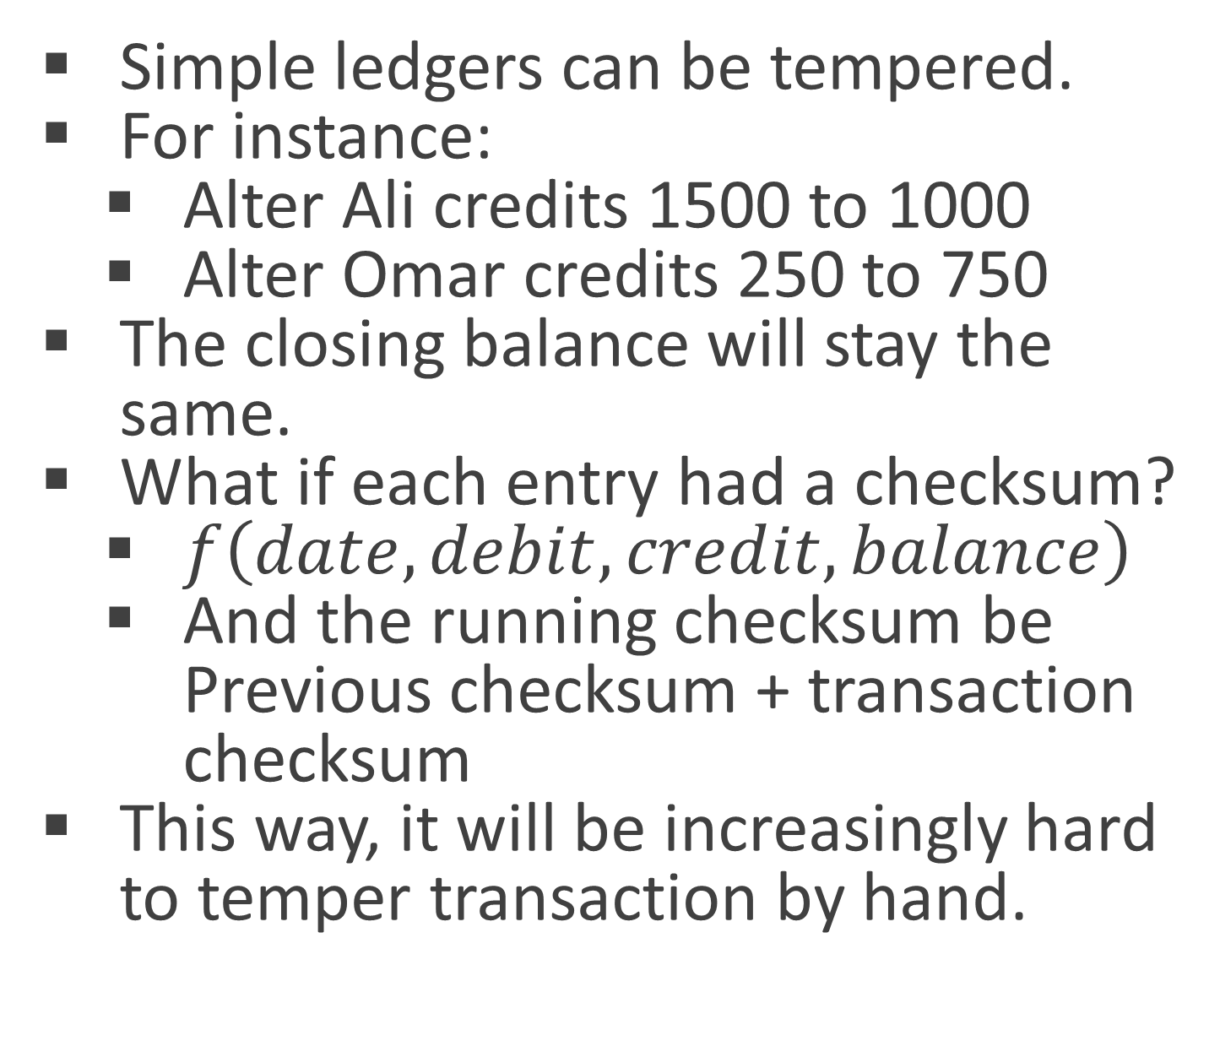
Blockchain & DeFi – Day 1
Blockchain
Simple ledgers can be tempered.
For instance:
  Alter Ali credits 1500 to 1000
  Alter Omar credits 250 to 750
The closing balance will stay the same.
What if each entry had a checksum?
  $f\left(date,debit,credit,balance\right)$
  And the running checksum be Previous checksum + transaction checksum
This way, it will be increasingly hard to temper transaction by hand.
Date | Particulars | Debit | Credit | Balance
01/01/26 | Opening | 5,000.00 |  | 5,000.00
02/01/26 | Zara |  | 800.00 | 4,200.00
03/01/26 | Omar | 100.00 |  | 4,300.00
04/01/26 | Sara |  | 25.00 | 4,275.00
05/01/26 | Ali |  | 1,500.00 | 2,775.00
06/01/26 | Zara | 200.00 |  | 2,975.00
07/01/26 | Omar | 30.00 |  | 3,005.00
08/01/26 | Sara | 500.00 |  | 3,505.00
09/01/26 | Ali |  | 300.00 | 3,205.00
10/01/26 | Omar |  | 250.00 | 2,955.00
 |  |  | Closing | 2,955.00
Notes:
Function f can be any mathematical function, e.g. the count of even digits * the count of odd digits.

Slide 7
Blockchain & DeFi – Day 1
Blockchain
However, the checksums have two weaknesses:
  They can conflict, i.e. two different transactions can produce same checksum.
  Checksum functions are primitive, modern computers can break them relatively easily.
Blockchains use something called a Hash to remedy these weaknesses.
Hashing is the process of generating a code of fixed length from data, which is collision-free and cannot be reverse-engineered.
A Hash can not show you the original data, but it can verify you.
Notes:
It’s like making ABC juice. You can’t retrieve Apple, Beetroot and Carrot back.
Recommended: https://www.youtube.com/watch?v=DMtFhACPnTY
Question! Why do password recoveries usually ask you to regenerate a new password rather than simply giving you your password?

Slide 8
Blockchain & DeFi – Day 1
Blockchain
Hashing is not the only security measure. Accounts in a blockchain are secured by so-called Asymmetric Encryption.
A cryptographic algorithm (e.g., Ethereum uses ECC – Elliptic Curve Cryptography) generates two keys when a new account is created:
  Public key: the Account number anybody can use to send assets, as well as read its transactions.
  Private key: the code which is used to unlock the account to perform transactions.
These look like, but are not random numbers. There is 1/10⁴⁸ chance of duplication.
Private key is the secret, which is never meant to be shared. It is not a password. It cannot be changed or retrieved if forgotten.
Notes:
Public-private key combination can be understood as a mailbox. Everyone can put a letter into it, only the mailbox owner has the key to unlock it.
Private key is generated first, then a public key is derived from it. The public key is what we call a Wallet address in the cryptocurrency world.
If entire population started creating a new wallet for entire population each second, it will take 5.5 trillion years to start noticing collisions

Slide 9
BLOCKCHAIN & DECENTRALIZED FINANCE
Opening your first Account

Slide 10
Practical Exercise/Demo
MetaMask
There are several free tools available for you to interact with Blockchains without going through complex protocols.
Among the most important ones is MetaMask.
MetaMask is an interface between you and the blockchain.
It does not actually hold your assets; it only provides a nice UI.
Trust Wallet, Coinbase Wallet, Phantom, etc. do the same.

Slide 11
Practical Exercise/Demo
Instructions
Visit MetaMask.io
Search and Install MetaMask extension from Extensions/Web Store.
Unfortunately, many ISPs block tools like Brave browser and Wallet providing services in the name of security.
Create a new Wallet: Choose “Use Recovery Phrase” option.
Enter a strong password (your responsibility to keep it safe).
Check “If I lose this password, MetaMask can’t reset it”.
Skip if you’re asked to Setup using Windows Hello.
Notes:
You can use Chrome-based browsers, but the most recommended browser is Brave. Firefox is second priority. Safari is a no-go.

Slide 12
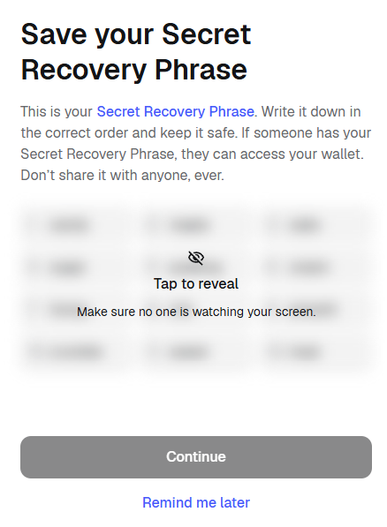
Practical Exercise/Demo
Instructions
Once you land on this screen, hide/dim your monitor. You may choose “Remind me later”
The password is temporary. The seed phrase is your Private key.
If you do not store Secret Recovery Phrase, you lose your account if MetaMask is reset.
Also disallow collecting data.
Notes:
You can use Chrome-based browsers, but the most recommended browser is Brave. Firefox is second priority. Safari is a no-go.

Slide 13
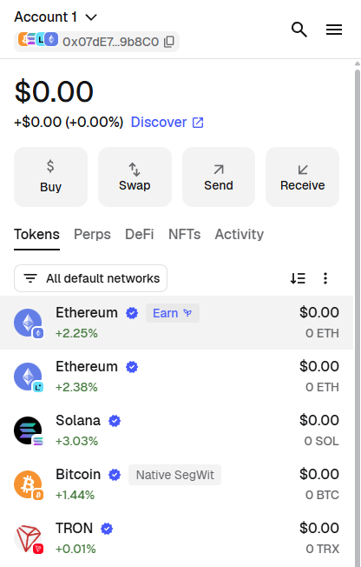
Practical Exercise/Demo
Instructions
Open your Wallet.
  The Wallet address/public key looks something like: 0x07dE….b8C0.
  This is your address for Ethereum’s blockchain opened on MetaMask.
  Blockchain is not one single entity. Bitcoin, Ethereum, Binance, Solana, Tron, etc. are separate blockchains independent of each other.

Slide 14
Practical Exercise/Demo
Instructions
Go to Menu (Top-right) > Networks > Enable “Show Test Networks”.
  This will allow you to view Sepolia, which is a Test network of Ethereum blockchain.
Finally, visit https://sepolia-faucet.pk910.de and enter your Wallet address to start mining SepETH (Sepolia Ethers) using your CPU.
Also, try asking ChatGPT for ways to obtain SepETH. You should each have at least 0.2SepETH
Email me your Wallet address to receive 0.1SepETH.

Slide 15
Practical Exercise/Demo
Next Week…
We discuss the first distributed ledger, i.e. Bitcoin.
How was Bitcoin created. The genesis block to current block.
What is mining and Proof of Work.
How to read, understand and verify a transaction on Bitcoin blockchain.
First transaction on Sepolia Testnet.

